Slide 1
Chapter 13: Architecture Patterns
Software architecture in Practice Chapter 13

Slide 2
Topics
What is a Pattern?
Pattern Catalog
  Module patterns
  Component and Connector Patterns
  Allocation Patterns

Slide 3
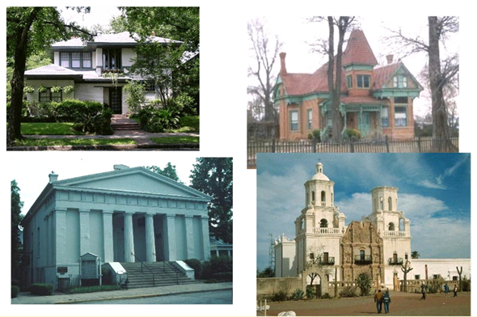
Architectural Styles (Patterns)

Slide 4

http://www.mushroomhouse.com/mushroom-house-exterior

Slide 5
Patterns – a Review
Work on software patterns stemmed from work on patterns for building architecture carried out by Christopher Alexander (A Pattern Language: Towns, Buildings, Construction (1977))
All well-structured software systems are full of patterns
  Architectural patterns – system level structural organization
  Design patterns – component level design
  Programming idioms – reoccurring constructs expressed in different languages (programming tasks, algorithms, data structures; e.g., increment counter)

Slide 6
An Architectural Pattern…
  Is a package of design decisions that is found repeatedly in practice
  Has known properties that permit reuse
  Describes a class of architectures

Slide 7
What is a Software Architectural Pattern?
A pattern is a solution to a problem in a context
  Context. A recurring, common situation in the world that gives rise to a problem.
  Problem. The problem, appropriately generalized, that arises in the given context.
  A solution. A successful architectural resolution to the problem, appropriately abstracted
An architectural pattern expresses a fundamental structural organization abstraction for software systems
  A set of structural elements
  Their relationships
  Rules and guidelines for organizing the relationships between them

Slide 8
Software Architecture Patterns
Versus software design patterns – higher level system wide in scope ; some overlap
  Recall the distinction between architecture and design work
Most software systems cannot be structured
according to a single architectural pattern
  Example: Design a system for flexibility of
  component distribution in a heterogeneous computer network and for adaptability of their user interfaces
How do you think about software design? Essentially the same cognitive process for architecture design …
  Requirements driven, separation of concerns, top-down, apply patterns

Slide 9
Describing a Pattern Solution
A pattern solution is determined and described by:
  A set of element types (for example, data repositories, processes, and objects)
  A set of interaction mechanisms or connectors (for example, method calls, events, or message bus)
  A topological layout of the components
  A set of semantic constraints covering topology, element behavior, and interaction mechanisms
  I.e., views
Organize patterns by predominant structure – module, connector, allocation

Slide 10
A Pattern Catalog
Module | Component & Connector | Allocation
Layered* | Broker* | Map-Reduce*
Domain decomposition | Model-View-Controller* | Multi-tier functional mapping*
 | Pipe-and-Filter* | Platform
 | Client-Server* | Team work allocation
 | Peer-to-Peer*
 | Service-Oriented Architecture*
 | Microservices*
 | Publish-Subscribe (Observer)*
 | Shared-Data*
 | Black Board*
 | Event Driven*
* Detailed below

Slide 11
Module Patterns
decomposition of the system

Slide 12
Layer Pattern
Context: Complex systems need to develop and evolve portions of the system independently. Developers need well-documented separation of concerns, so system modules may be independently developed and maintained.
Problem: The software needs to be segmented in such a way that the modules can be developed and evolved separately with little interaction among the parts, supporting portability, modifiability, and reuse.
Solution: To achieve this separation of concerns, the layered pattern divides the software into units called layers. Each layer is a grouping of modules that offers a cohesive set of services. The usage must be unidirectional. Layers completely partition a set of software, and each partition is exposed through a public interface.

Slide 13
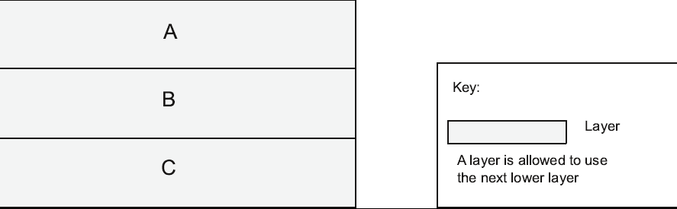
Layer Pattern Example

Slide 14
UML Package Notation for Layer Diagrams
Note: The textbook uses various informal architecture notations. That is OK if you use legends (keys) to explain the components, connectors, and structures.

Slide 15
Business IT Example
Software Architecture Patterns, Mark Richards

Slide 16
Layer Pattern Solution
Overview: The layered pattern defines layers (groupings of modules that offer a cohesive set of services) and a unidirectional allowed-to-use relation among the layers.
Elements: Layer, a kind of module. The description of a layer should define what modules the layer contains.
Relations: Allowed to use. The design should define what the layer usage rules are and any allowable exceptions.
Constraints:
  Every piece of software is allocated to exactly one layer.
  There are at least two layers (but usually there are three or more).
  The allowed-to-use relations should not be circular (i.e., a lower layer cannot use a layer above).
Weaknesses:
  The addition of layers adds up-front cost and complexity to a system.
  Layers contribute a performance penalty.

Slide 17
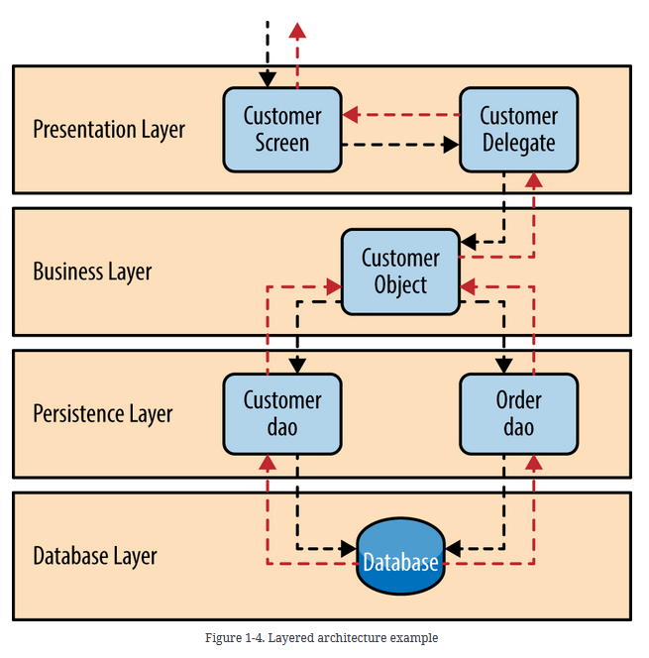
Software Architecture Patterns
by Mark Richards

Slide 18
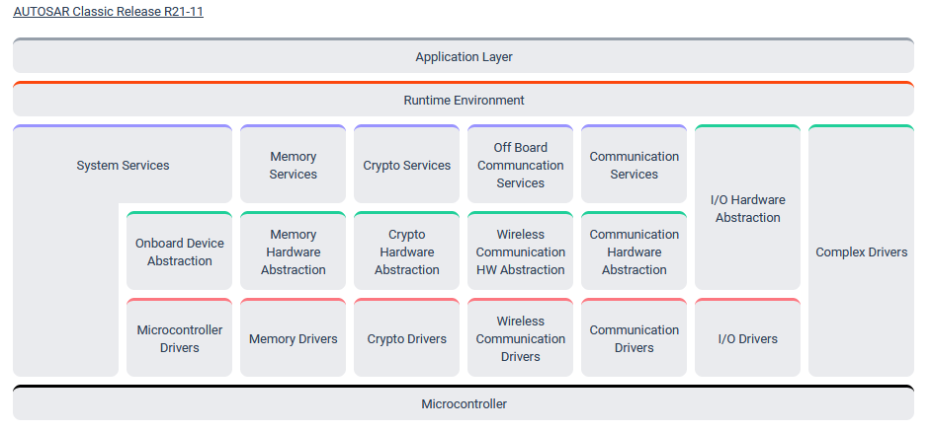
AUTOSAR Layered Architecture

Slide 19
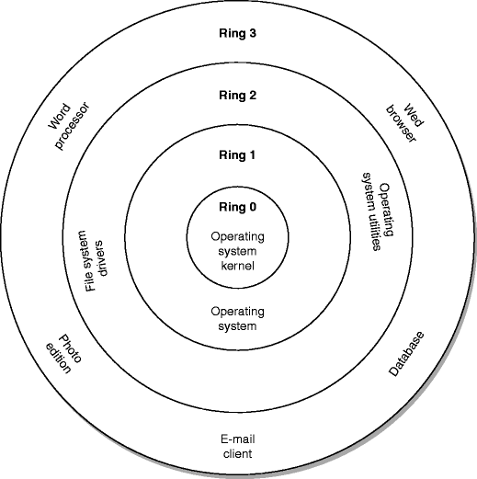
Other Module Patterns
Domain Decomposition – Application specific domain decomposition of a system.
Computer Security:

Slide 20
Component and Connector Patterns
Connecting the system together

Slide 21
Broker Pattern
Context: Many systems are constructed from a collection of services distributed across multiple servers. Implementing these systems is complex because you need to worry about how the systems will interoperate—how they will connect to each other and how they will exchange information—as well as the availability of the component services.
Problem: How do we structure distributed software so that service users do not need to know the nature and location of service providers, making it easy to dynamically change the bindings between users and providers?
Solution: The broker pattern separates users of services (clients) from providers of services (servers) by inserting an intermediary, called a broker. When a client needs a service, it queries a broker via a service interface. The broker then forwards the client’s service request to a server, which processes the request.

Slide 22
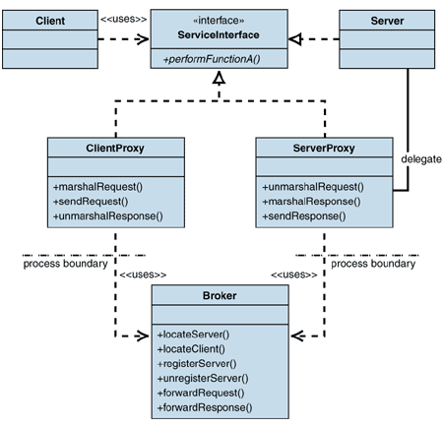
Broker Example

Slide 23
Broker Example

Slide 24
Broker Solution – 1
Overview: The broker pattern defines a runtime component, called a broker, that mediates the communication between a number of clients and servers.
Elements:
  Client, a requester of services
  Server, a provider of services
  Broker, an intermediary that locates an appropriate server to fulfill a client’s request, forwards the request to the server, and returns the results to the client
  Client-side proxy, an intermediary that manages the actual communication with the broker, including marshaling, sending, and unmarshaling of messages
  Server-side proxy, an intermediary that manages the actual communication with the broker, including marshaling, sending, and unmarshaling of messages

Slide 25
Broker Solution - 2
Relations: The attachment relation associates clients (and, optionally, client-side proxies) and servers (and, optionally, server-side proxies) with brokers.
Constraints: The client can only attach to a broker (potentially via a client-side proxy). The server can only attach to a broker (potentially via a server-side proxy).
Weaknesses:
  Brokers add a layer of indirection, and hence latency, between clients and servers, and that layer may be a communication bottleneck.
  The broker can be a single point of failure.
  A broker adds up-front complexity.
  A broker may be a target for security attacks.
  A broker may be difficult to test.

Slide 26
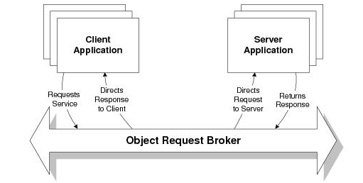
Broker Patterns in the wild
CORBA: Common Object Request Broker Architecture
  Actively developed from 1991 – 2002
Enterprise Java Beans
Microsoft .NET Platform
Apache Kafka
Service Oriented Architectures (covered later) depend on the Broker Pattern
COBRA Programming Model

Slide 27
Model-View-Controller Pattern
Context: User interface software is typically the most frequently modified portion of an interactive application. Users often wish to look at data from different perspectives, such as a bar graph or a pie chart. These representations should both reflect the current state of the data.
Problem: How can user interface functionality be kept separate from application functionality and yet still be responsive to user input, or to changes in the underlying application’s data? And how can multiple views of the user interface be created, maintained, and coordinated when the underlying application data changes?
Solution: The model-view-controller (MVC) pattern separates application functionality into three kinds of components:
  A model, which contains the application’s data
  A view, which displays some portion of the underlying data and interacts with the user
  A controller, which mediates between the model and the view and manages the notifications of state changes

Slide 28
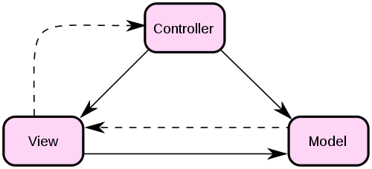
MVC Example
Manage user requests
Initiates model behavior
Select view response
User events
View selection
State Change
Change notification
State query
Receives model data
Requests model data
Presents view
Encapsulates application
functions and data
Invocations
Events

Slide 29
MVC Solution - 1
Overview: The MVC pattern breaks system functionality into three components: a model, a view, and a controller that mediates between the model and the view.
Elements:
  The model is a representation of the application data or state, and it contains (or provides an interface to) application logic.
  The view is a user interface component that either produces a representation of the model for the user or allows for some form of user input, or both.
  The controller manages the interaction between the model and the view, translating user actions into changes to the model or changes to the view.

Slide 30
MVC Solution - 2
Relations: The notifies relation connects instances of model, view, and controller, notifying elements of relevant state changes.
Constraints:
  There must be at least one instance each of model, view, and controller.
  The model component should not interact directly with the controller.
Weaknesses:
  The complexity may not be worth it for simple user interfaces.
  The model, view, and controller abstractions may not be good fits for some user interface toolkits.

Slide 31
Pipe and Filter Pattern
Context: Many systems are required to transform streams of discrete data items, from input to output. Many types of transformations occur repeatedly in practice, and so it is desirable to create these as independent, reusable parts.
Problem: Such systems need to be divided into reusable, loosely coupled components with simple, generic interaction mechanisms. In this way they can be flexibly combined with each other. The components, being generic and loosely coupled, are easily reused. The components, being independent, can execute in parallel.
Solution: The pattern of interaction in the pipe-and-filter pattern is characterized by successive transformations of streams of data. Data arrives at a filter’s input port(s), is transformed, and then is passed via its output port(s) through a pipe to the next filter. A single filter can consume data from, or produce data to, one or more ports.

Slide 32
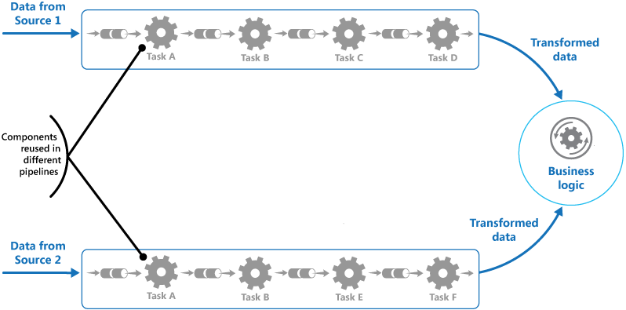
Pipe and Filter Example

Slide 33
Pipe and Filter Solution
Overview: Data is transformed from a system’s external inputs to its external outputs through a series of transformations performed by its filters connected by pipes.
Elements:
  Filter, which is a component that transforms data read on its input port(s) to data written on its output port(s).
  Pipe, which is a connector that conveys data from a filter’s output port(s) to another filter’s input port(s). A pipe has a single source for its input and a single target for its output. A pipe preserves the sequence of data items, and it does not alter the data passing through.
Relations: The attachment relation associates the output of filters with the input of pipes and vice versa.
Constraints:
  Pipes connect filter output ports to filter input ports.
  Connected filters must agree on the type of data being passed along the connecting pipe.

Slide 34
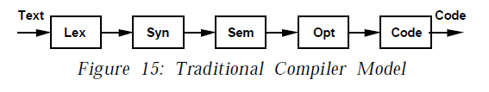
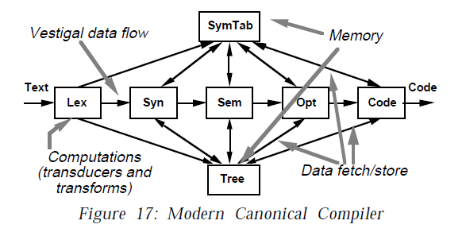
Pipeline Architecture Examples
Garlan, David, and Mary Shaw. “AN INTRODUCTION TO SOFTWARE ARCHITECTURE.”

Slide 35
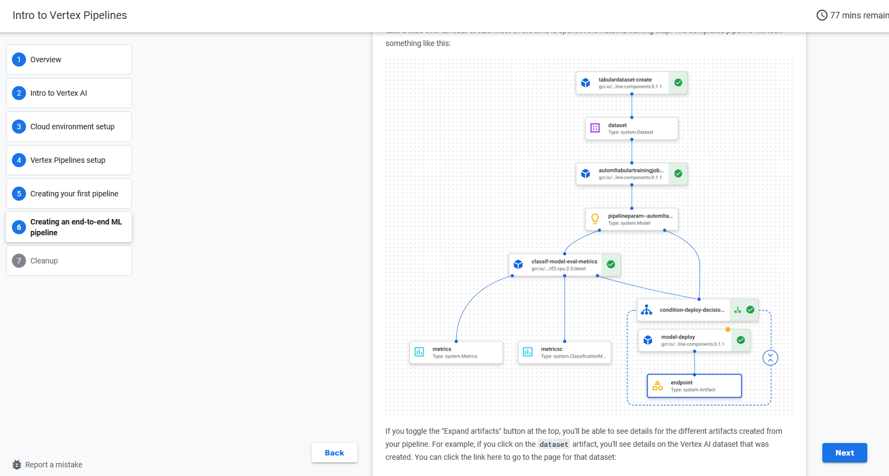
https://codelabs.developers.google.com/vertex-pipelines-intro#5

Slide 36
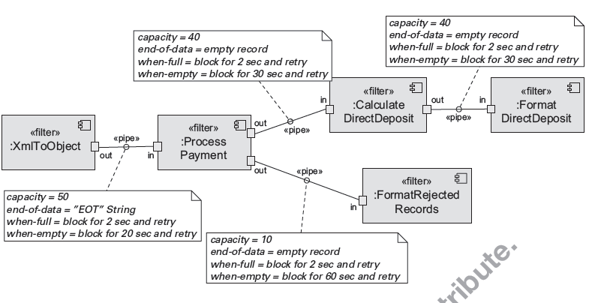
Pipe and Filter Example

Slide 37
Client-Server Pattern
Context: There are shared resources and services that large numbers of distributed clients wish to access, and for which we wish to control access or quality of service.
Problem: By managing a set of shared resources and services, we can promote modifiability and reuse, by factoring out common services and having to modify these in a single location, or a small number of locations. We want to improve scalability and availability by centralizing the control of these resources and services, while distributing the resources themselves across multiple physical servers.
Solution: Clients interact by requesting services of servers, which provide a set of services. Some components may act as both clients and servers. There may be one central server or multiple distributed ones.

Slide 38
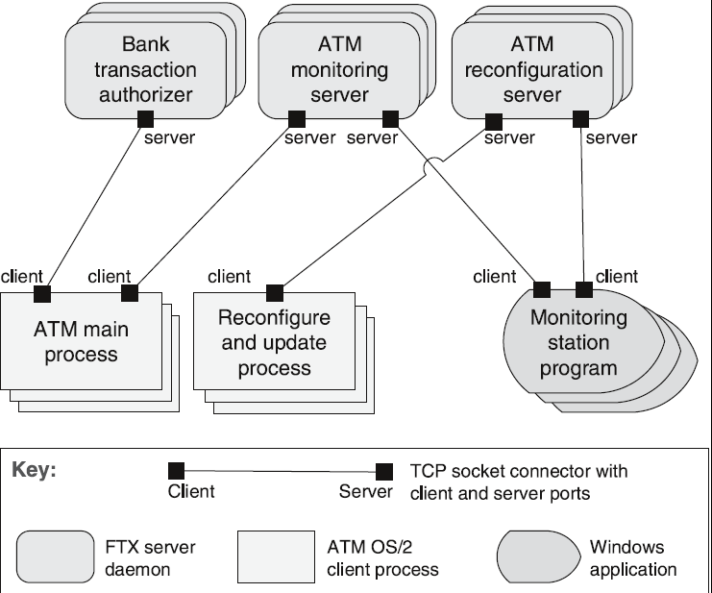
Client-Server Example
ATM Banking System

Slide 39
Client-Server Solution - 1
Overview: Clients initiate interactions with servers, invoking services as needed from those servers and waiting for the results of those requests.
Elements:
  Client, a component that invokes services of a server component. Clients have ports that describe the services they require.
  Server: a component that provides services to clients. Servers have ports that describe the services they provide.
Request/reply connector: a data connector employing a request/reply protocol, used by a client to invoke services on a server. Important characteristics include whether the calls are local or remote, and whether data is encrypted.

Slide 40
Client-Server Solution- 2
Relations: The attachment relation associates clients with servers.
Constraints:
  Clients are connected to servers through request/reply connectors.
  Server components can be clients to other servers.
Weaknesses:
  Server can be a performance bottleneck.
  Server can be a single point of failure.
  Decisions about where to locate functionality (in the client or in the server) are often complex and costly to change after a system has been built.

Slide 41
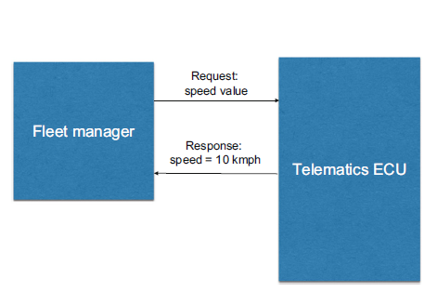
Client Server from Automotive Software Architecture

Slide 42
Peer-to-Peer Pattern
Context: Distributed computational entities—each of which is considered equally important in terms of initiating an interaction and each of which provides its own resources—need to cooperate and collaborate to provide a service to a distributed community of users.
Problem: How can a set of “equal” distributed computational entities be connected to each other via a common protocol so that they can organize and share their services with high availability and scalability?
Solution: In the peer-to-peer (P2P) pattern, components directly interact as peers. All peers are “equal” and no peer or group of peers can be critical for the health of the system. Peer-to-peer communication is typically a request/reply interaction without the asymmetry found in the client-server pattern.

Slide 43
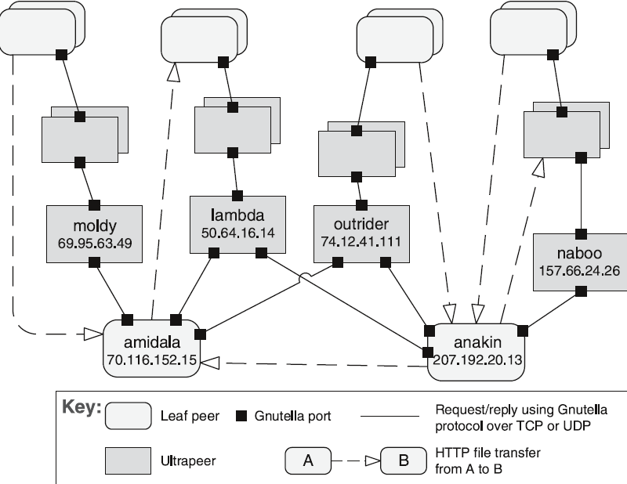
Peer-to-Peer Example
Gnutella Network

Slide 44
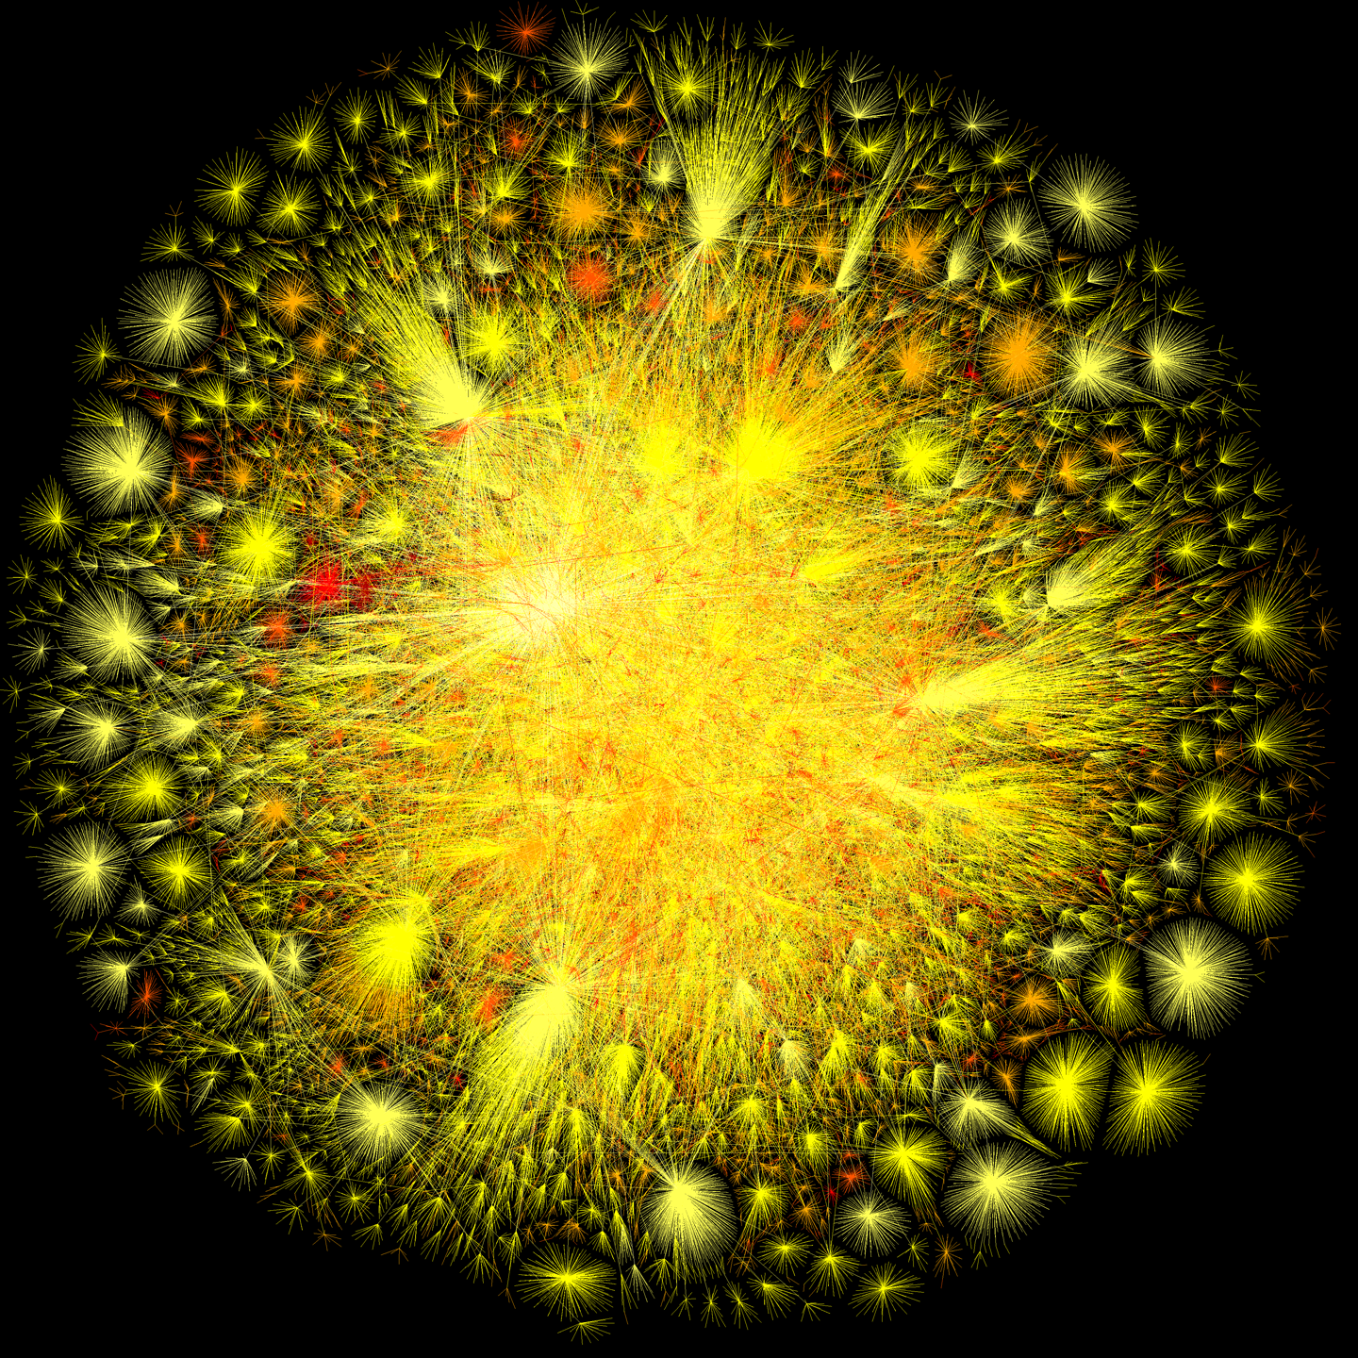
The Internet in 2010
The color selection is based on the color of incandescence, where the most connection points represent the highest temperatures in terms of colors of light.
http://videobot.ash1.opte.org/content/opte/maps/static/opte-2010.png

Slide 45
Peer-to-Peer Solution - 1
Overview: Computation is achieved by cooperating peers that request service from and provide services to one another across a network.
Elements:
  Peer, which is an independent component running on a network node. Special peer components can provide routing, indexing, and peer search capability.
  Request/reply connector, which is used to connect to the peer network, search for other peers, and invoke services from other peers. In some cases, the need for a reply is done away with.
Relations: The relation associates peers with their connectors. Attachments may change at runtime.

Slide 46
Peer-to-Peer Solution - 2
Constraints: Restrictions may be placed on the following:
  The number of allowable attachments to any given peer
  The number of hops used for searching for a peer
  Which peers know about which other peers
  Some P2P networks are organized with star topologies, in which peers only connect to supernodes.
Weaknesses:
  Managing security, data consistency, data/service availability, backup, and recovery are all more complex.
  Small peer-to-peer systems may not be able to consistently achieve quality goals such as performance and availability.

Slide 47
Service Oriented Architecture Pattern
Context: A number of services are offered (and described) by service providers and consumed by service consumers. Service consumers need to be able to understand and use these services without any detailed knowledge of their implementation.
Problem: How can we support interoperability of distributed components running on different platforms and written in different implementation languages, provided by different organizations, and distributed across the Internet?
Solution: The service-oriented architecture (SOA) pattern describes a collection of distributed components that provide and/or consume services.

Slide 48
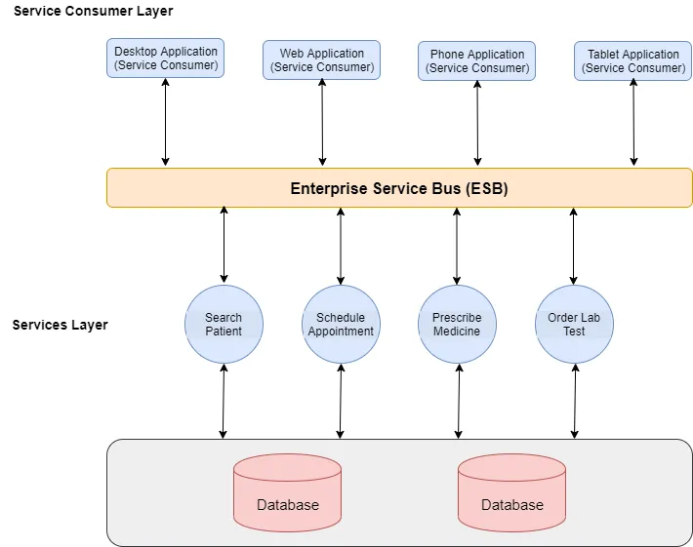
https://medium.com/@adeelsarwarblog/what-is-service-oriented-architecture-9b4406fcedeb

Slide 49
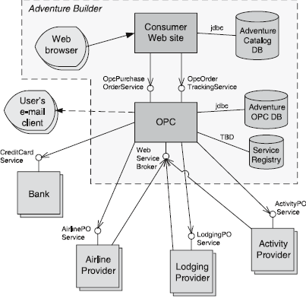
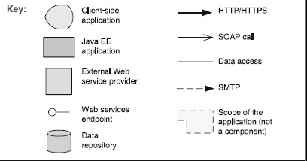
Service Oriented Architecture Example
“Adventure Builder”
OPC – Order Processing Center

Slide 50
Service Oriented Architecture Solution - 1
Overview: Computation is achieved by a set of cooperating components that provide and/or consume services over a network.
Elements:
  Components:
    Service providers, which provide one or more services through published interfaces.
    Service consumers, which invoke services directly or through an intermediary.
    Service providers may also be service consumers.
  Enterprise Service Bus (ESB), which is an intermediary element that can route and transform messages between service providers and consumers.
  Registry of services, which may be used by providers to register their services and by consumers to discover services at runtime.
  Orchestration server, which coordinates the interactions between service consumers and providers based on languages for business processes and workflows.

Slide 51
Service Oriented Architecture Solution - 2
  Connectors:
    SOAP connector, which uses the SOAP protocol for synchronous communication between web services, typically over HTTP.
    REST connector, which relies on the basic request/reply operations of the HTTP protocol.
    Asynchronous messaging connector, which uses a messaging system to offer point-to-point or publish-subscribe asynchronous message exchanges.

Slide 52
Service Oriented Architecture Solution - 3
Relations: Attachment of the different kinds of components available to the respective connectors
Constraints: Service consumers are connected to service providers, but intermediary components (e.g., ESB, registry, orchestration server) may be used.
Weaknesses:
  SOA-based systems are typically complex to build.
  You don’t control the evolution of independent services.
  There is a performance overhead associated with the middleware, and services may be performance bottlenecks, and typically do not provide performance guarantees.

Slide 53
Microservices Architecture Pattern
Context - deploy server based enterprise applications that support a variety of browser and native mobile clients. The application handles client requests by executing business logic, accessing a database, exchanging messages with other systems, and returning responses. The application might expose a 3rd party API.
Problem – Monolithic applications can become too large and complex for efficient support, and deployment for optimal distributed resource utilization such as in cloud environments
Solution - build applications as suites of services. Each service is independently deployable and scalable, and has its own API boundary. Different services can be written in different programming languages, manage their own database, and developed by different teams
http://martinfowler.com/articles/microservices.html

Slide 54
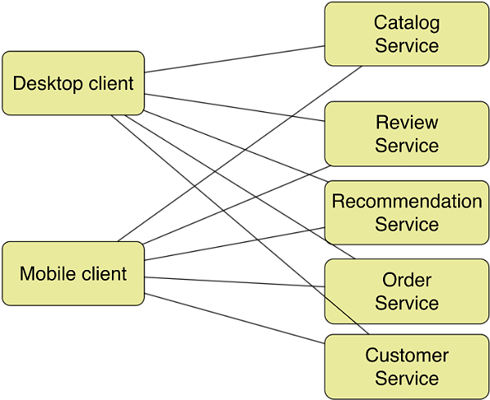
Microservices Architecture Pattern Example
Used by Amazon and Netflix

Slide 55
Microservices Architecture Pattern Solution
Overview – decompose business logic into a series of independently developed and deployable services
Elements – services are packaged as out-of-process components with well defined service boundaries (APIs). They can be implemented in any programming language. They may manage their own database as part of the service boundary.
Relationships – clients invoke services via simple remote procedure calls/web services using for example HTTP RESTful interfaces, or using a lightweight message bus.
Constraints – complexity of distributed systems. Decentralized data management is harder to manage such as support for cross service transactions. Development team experience to make good service decomposition decisions, testing and deployment know how
Weaknesses – systems must be designed to tolerate service failures which requires more system monitoring. Service choreography and event collaboration overhead. More memory

Slide 56
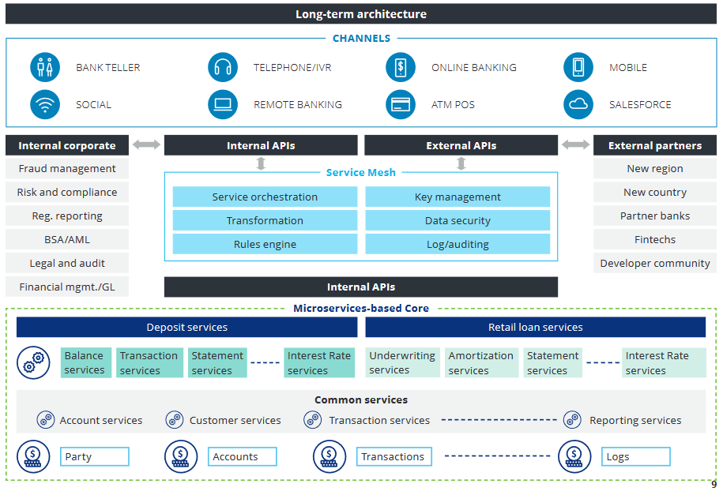
https://www2.deloitte.com/content/dam/Deloitte/us/Documents/financial-services/us-enabling-platform-banking-pov.pdf

Slide 57
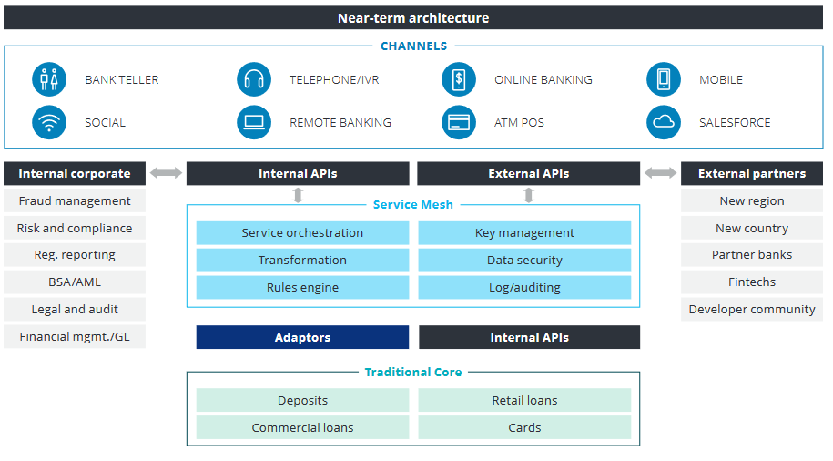

Slide 58
Event Driven Architecture
Context – computational and information resources need to be provided to handle incoming independent asynchronous application generated events in a manner that can scale up as demand increases.
Problem – construct distributed systems that can service asynchronous arriving messages associate with an event, and that can scale from small and simple to large and complex.
Solution – deploy independent event processes/processors for event handling. Arriving events are queued. A scheduler pulls events from the queue and distributes them to the appropriate event handler based on a scheduling policy.
Software Architecture Patterns, Mark Richards

Slide 59
Event Driven Architecture Example
Mediator topology – orchestrate multiple steps to handle an event according to some application policy
Broker topology – distribute messages in a simple chained message flow
Software Architecture Patterns, Mark Richards

Slide 60
Event Driven Architecture Pattern Solution
Overview – arriving client generated requests for service arrive as events. They are queued, and then directed to an appropriate event handler according to some application policy. This pattern can be used in a wide range of applications.
Elements – the event queue, the scheduler, and the collection of pertinent event handlers. Event handlers may be deployed as independent processes and/or processors.
Relationships – clients and event handlers are usually distributed on a network but do not have to be. Message communication protocols and message formats should be consistent and standards based
Constraints – there is no built-in transactional support. The inherent complexity of deploying distributed systems.
Weaknesses – performance and error recovery may be issues. On the plus side, with low coupling the resulting systems are highly scalable.
Software Architecture Patterns, Mark Richards

Slide 61
Publish-Subscribe Pattern
Context: There are a number of independent producers and consumers of data that must interact. The precise number and nature of the data producers and consumers are not predetermined or fixed, nor is the data that they share.
Problem: How can we create integration mechanisms that support the ability to transmit messages among the producers and consumers so they are unaware of each other’s identity, or potentially even their existence?
Solution: In the publish-subscribe pattern, components interact via announced messages, or events. Components may subscribe to a set of events. Publisher components place events on the bus by announcing them; the connector then delivers those events to the subscriber components that have registered an interest in those events.

Slide 62
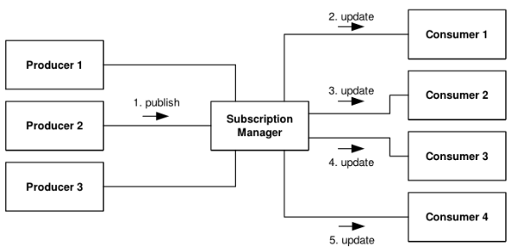
Publish-Subscribe Example

Slide 63
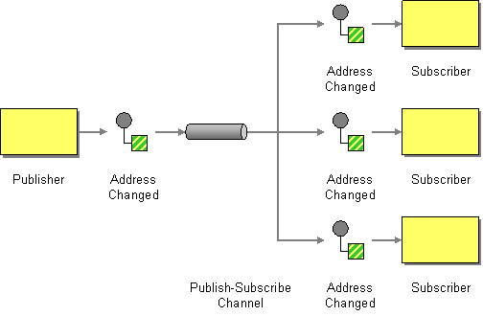
Publish-Subscribe Example
http://www.enterpriseintegrationpatterns.com/patterns/messaging/PublishSubscribeChannel.html

Slide 64
Publish-Subscribe Solution – 1
Overview: Components publish and subscribe to events. When an event is announced by a component, the connector infrastructure dispatches the event to all registered subscribers.
Elements:
  Any C&C component with at least one publish or subscribe port.
  The publish-subscribe connector, which will have announce and listen roles for components that wish to publish and subscribe to events.
Relations: The attachment relation associates components with the publish-subscribe connector by prescribing which components announce events and which components are registered to receive events.

Slide 65
Publish-Subscribe Solution - 2
Constraints: All components are connected to an event distributor that may be viewed as either a bus—connector—or a component. Publish ports are attached to announce roles and subscribe ports are attached to listen roles.
Weaknesses:
  Typically increases latency and has a negative effect on scalability and predictability of message delivery time.
  Less control over ordering of messages, and delivery of messages is not guaranteed.

Slide 66
Shared-Data Pattern
Context: Various computational components need to share and manipulate large amounts of data. This data does not belong solely to any one of those components.
Problem: How can systems store and manipulate persistent data that is accessed by multiple independent components?
Solution: In the shared-data pattern, interaction is dominated by the exchange of persistent data between multiple data accessors and at least one shared-data store. Exchange may be initiated by the accessors or the data store. The connector type is data reading and writing.

Slide 67
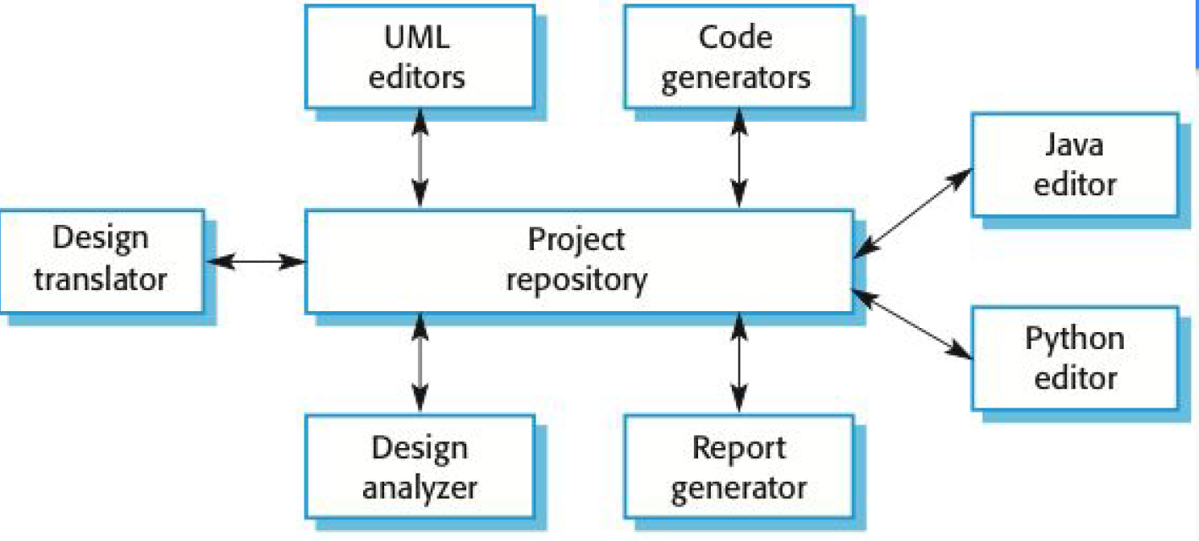
Shared Data Example

Slide 68
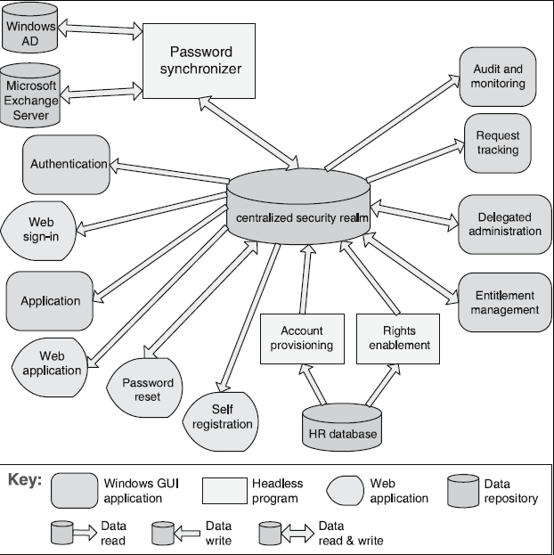
Shared Data Example
Enterprise Access Management System

Slide 69
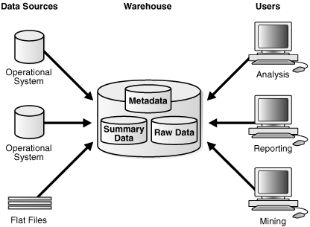
Data Warehouse Example
Oracle – Introduction to Data Warehousing Concepts

Slide 70
Shared Data Solution - 1
Overview: Communication between data accessors is mediated by a shared data store. Control may be initiated by the data accessors or the data store. Data is made persistent by the data store.
Elements:
  Shared-data store. Concerns include types of data stored, data performance-oriented properties, data distribution, and number of accessors permitted.
  Data accessor component.
  Data reading and writing connector.

Slide 71
Shared Data Solution - 2
Relations: Attachment relation determines which data accessors are connected to which data stores.
Constraints: Data accessors interact only with the data store(s).
Weaknesses:
  The shared-data store may be a performance bottleneck.
  The shared-data store may be a single point of failure.
  Producers and consumers of data may be tightly coupled.

Slide 72
Blackboard Pattern
Context - An immature or poorly specified domain with no deterministic or optimal solution known for the problem. Hence, software systems that need to integrate large and diverse specialized modules, and implement complex, nondeterministic control strategies. E.g., speech recognition, other AI “expert” applications. Metaphor of humans collaborating with a blackboard.
Problem –The problem spans several fields of expertise that require a sequence of independent algorithmic transformations. Intermediate solutions require different representations. Algorithm experimentation may be required. The control strategy is complex and cannot be determined statically.
Solution - a collection of independent specialized programs work cooperatively utilizing a common data structure. A central controller coordinates the knowledge sources based on the state of the solution.

Slide 73
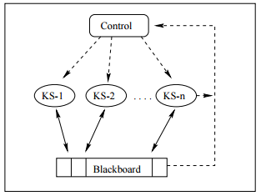
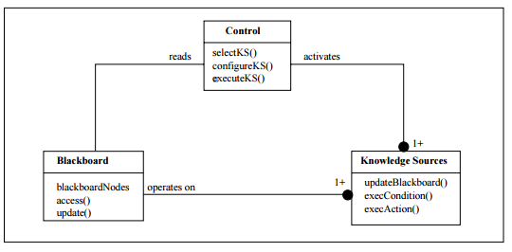
Blackboard Example

Slide 74
Blackboard Solution - 1
Overview - Problem solvers work independently (and opportunistically) on parts of the problem. They share a common data structure (the blackboard). A central controller manages access to the blackboard. The blackboard may be structured (e.g. into levels of abstraction) so problem solvers may work at different levels. Blackboard contains original input and/or partial solutions
Elements
  Knowledge source - separate, independent subsystems that solve specific aspects of the overall problem
  Blackboard - the central data store for solution space and control data It provides an interface to enable knowledge source access
  Control – uses data in the blackboard to coordinate the sequence interaction between knowledge sources

Slide 75
Blackboard Solution – 2
Relations – knowledge sources are completely independent. They are coordinated by the state of data in the blackboard and control directed actuation.
Constraints – computationally expensive, low support for parallelism, no good solution is guaranteed, control solution may be heuristic
Weaknesses - Difficulty of testing, may be hard to develop

Slide 76
Allocation Patterns
Defining where components Reside

Slide 77
Map-Reduce Pattern
Context: Businesses have a pressing need to quickly analyze enormous volumes of data they generate or access, at petabyte scale.
Problem: For many applications with ultra-large data sets, sorting the data and then analyzing the grouped data is sufficient. The problem the map-reduce pattern solves is to efficiently perform a distributed and parallel sort of a large data set and provide a simple means for the programmer to specify the analysis to be done.
Solution: The map-reduce pattern requires three parts:
  A specialized infrastructure takes care of allocating software to the hardware nodes in a massively parallel computing environment and handles sorting the data as needed.
  A programmer specified component called the map which filters the data to retrieve those items to be combined.
  A programmer specified component called reduce which combines the results of the map

Slide 78
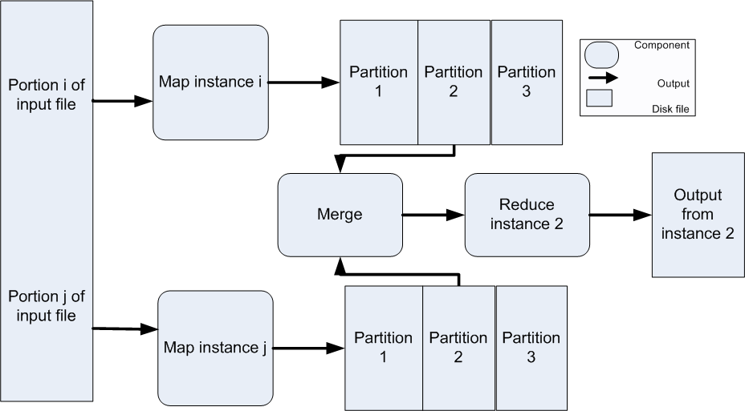
Map-Reduce Example

Slide 79
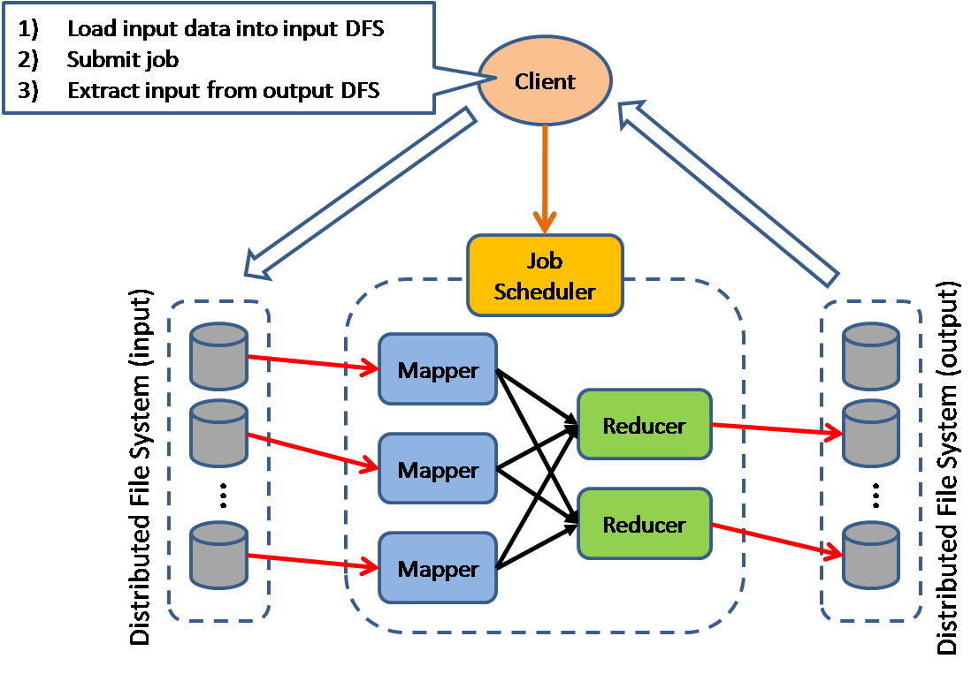
Another Map-Reduce View

Slide 80
Map-Reduce Solution - 1
Overview: The map-reduce pattern provides a framework for analyzing a large distributed set of data that will execute in parallel, on a set of processors. This parallelization allows for low latency and high availability. The map performs the extract and transform portions of the analysis and the reduce performs the loading of the results.
Elements:
  Map is a function with multiple instances deployed across multiple processors that performs the extract and transformation portions of the analysis.
  Reduce is a function that may be deployed as a single instance or as multiple instances across processors to perform the load portion of extract-transform-load.
  The infrastructure is the framework responsible for deploying map and reduce instances, shepherding the data between them, and detecting and recovering from failure.

Slide 81
Map-Reduce Solution - 2
Relations:
  Deploy on is the relation between an instance of a map or reduce function and the processor onto which it is installed.
  Instantiate, monitor, and control is the relation between the infrastructure and the instances of map and reduce.
Constraints:
  The data to be analyzed must exist as a set of files.
  Map functions are stateless and do not communicate with each other.
  The only communication between map reduce instances is the data emitted from the map instances as <key, value> pairs.
Weaknesses:
  If you do not have large data sets, the overhead of map-reduce is not justified.
  If you cannot divide your data set into similar sized subsets, the advantages of parallelism are lost.
  Operations that require multiple reduces are complex to orchestrate.

Slide 82
Multi-Tier Pattern
Context: In a distributed deployment, there is often a need to distribute a system’s infrastructure into distinct subsets.
Problem: How can we split the system into a number of computationally independent execution structures—groups of software and hardware—connected by some communications media?
Solution: The execution structures of many systems are organized as a set of logical groupings of components. Each grouping is termed a tier.

Slide 83
Multi-Tier Example
Consumer Web Site Java EE

Slide 84
Multi-Tier Solution
Overview: The execution structures of many systems are organized as a set of logical groupings of components. Each grouping is termed a tier.
Elements:
  Tier, which is a logical grouping of software components.
Relations:
  Is part of, to group components into tiers.
  Communicates with, to show how tiers and the components they contain interact with each other.
  Allocated to, in the case that tiers map to computing platforms.
Constraints: A software component belongs to exactly one tier.
Weaknesses: Substantial up-front cost and complexity.

